Slide 1
Recitation 03
Pointers
George Mappouras
9/10/2015

Slide 2
What is a pointer?
It’s a “type” (like int or char)
It stores an address (of specific type)

Slide 3
What is an address? Why is it needed
It is used to refer to places in memory (or nowhere…)
Used to pass a variable to a function by reference! (and other reasons)
Example:
void swap1 (int x, int y){
int temp = x;
x=y;
y=temp;
}
void swap2 (int *x, int *y){
int temp = *x;
*x=*y;
*y=temp;
}

Slide 4
The * vs &
The symbol * next to a variable means:
Take the context of the variable, use it as an address, and lead me to the memory with that address
The symbol & next to a variable means:
Tell me the address of the memory location that stores this variable

Slide 5
Example 1
int x = 5;
int *p1 = *x;
int *p2 = &x;
Which of the two pointers refers to x?
Answer:

Slide 6
Example 1
int x = 5;
int *p1 = *x;
int *p2 = &x;
Which of the two pointers refers to x?
Answer: p2

Slide 7
Pointer of a pointer?
address1 x=5
int x = 5;
int *p1 = &x;
int **p2 = &p1;
Pointers are also in memory! Their memory locations has an address!
What is the result of *(*p2)?
address4 p1=address1
address24 p2=address4

Slide 8
Pointer of a pointer?
address1 x=5
int x = 5;
int *p1 = &x;
int **p2 = &p1;
Pointers are also in memory! Their memory locations has an address!
What is the result of *(*p2)?
Answer: *(*p2) = *(address1) = x = 5
address4 p1=address1
address24 p2=address4

Slide 9
The Null pointer
5
Does node 1 exists in the current tree?
What about initializations?
2
10
null
null
7
12
null
null
null
null

Slide 10
Segmentation Fault (SF)
Trying to access memory locations that do not belong in my program lead to SF
Which of the references below would cause a SF?
1) int x2=*pointer;
2) int *x2 = &pointer;
3) int *x2 = pointer + 2;
4) int x2 = *(&x1 + 10);
Other program 1
Address3 x = 5
Address4 pointer = Address9
My programs memory space
Address6 pointer_to_x = Address7
Address7
Other program 2

Slide 11
Segmentation Fault (SF)
Trying to access memory locations that do not belong in my program lead to SF
Which of the references below would cause a SF?
1) int x2=*pointer; YES
2) int *x2 = &pointer; NO
3) int *x2 = pointer + 2; NO
4) int x2 = *(&x1 + 10); YES
What about pointer_to_x ?
Other program 1
Address3 x = 5
Address4 pointer = Address9
My programs memory space
Address6 pointer_to_x = Address7
Address7
Other program 2

Slide 12
Exercise 1
What is the result of the program below?
int count = 10, *temp, sum = 0;
temp = &count;
*temp = 20;
temp = &sum;
*temp = count;
printf("count = %d, *temp = %d, sum = %d\n", count, *temp, sum );

Slide 13
Exercise 1
What is the result of the program below?
int count = 10, *temp, sum = 0;
temp = &count;
*temp = 20;
temp = &sum;
*temp = count;
printf("count = %d, *temp = %d, sum = %d\n", count, *temp, sum );
Answer: count = 20, *temp = 20, sum = 20

Slide 14
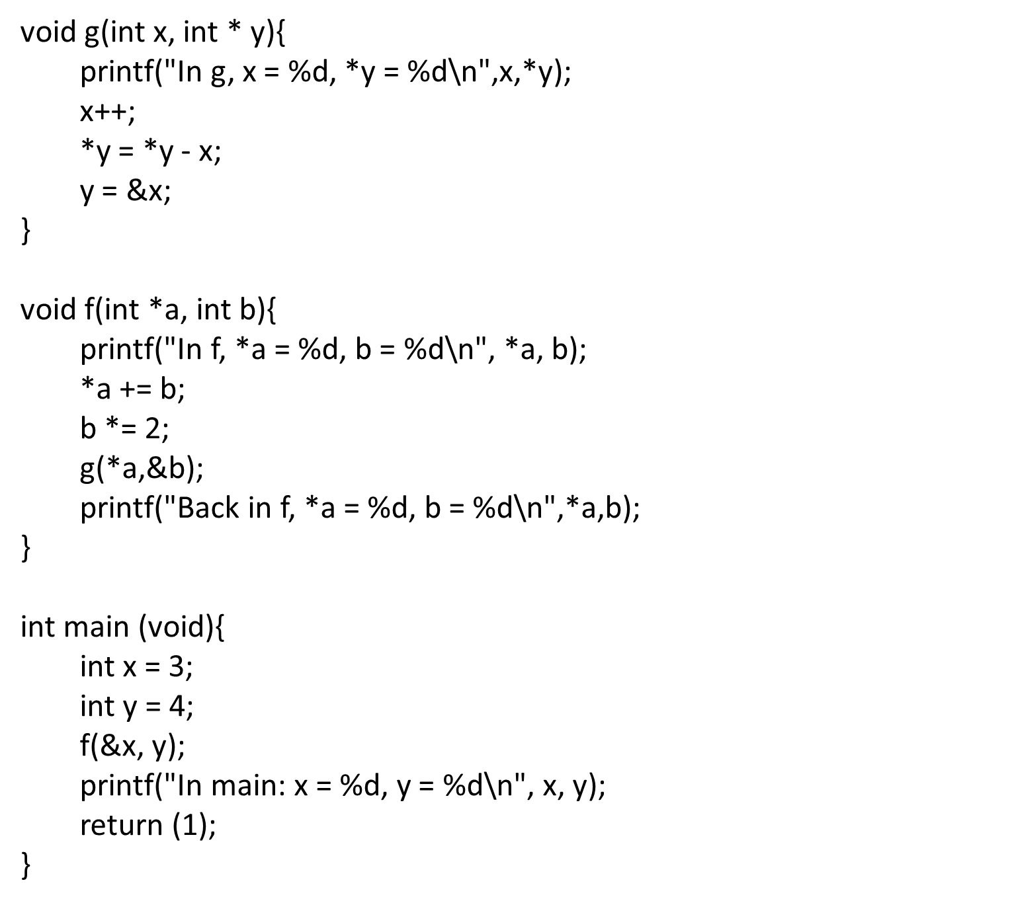
Exercise 2: All of programing (page 145 of the book/ 171 of the pdf)

Slide 15
Exercise 2: All of programing (page 145 of the book/ 171 of the pdf)
In f, *a = 3, b = 4
In g, x = 7, *y = 8
Back in f, *a = 7, b = 0
In main: x = 7, y = 4
Answer:

